Slide 1
OMAP4470 Android Composition
w/ Vivante GC320
Jonathan Bergsagel
February 3, 2012

Slide 2
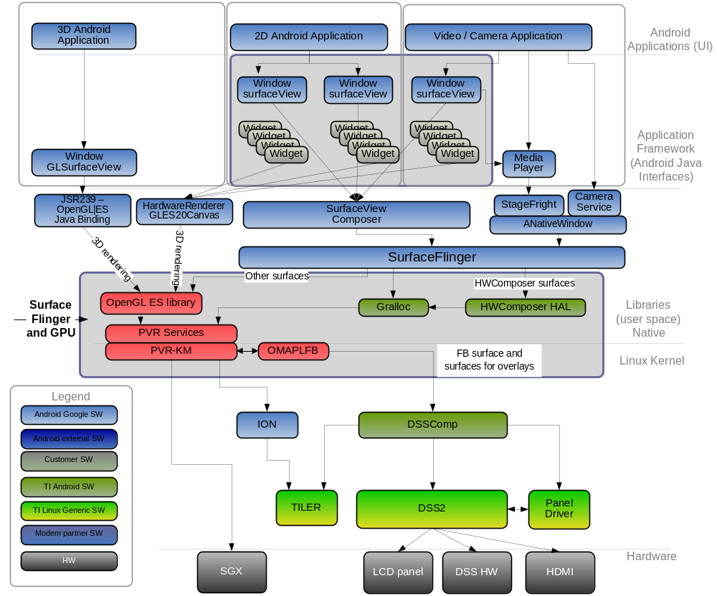
OMAP4430/4460 Composition Architecture

Slide 3
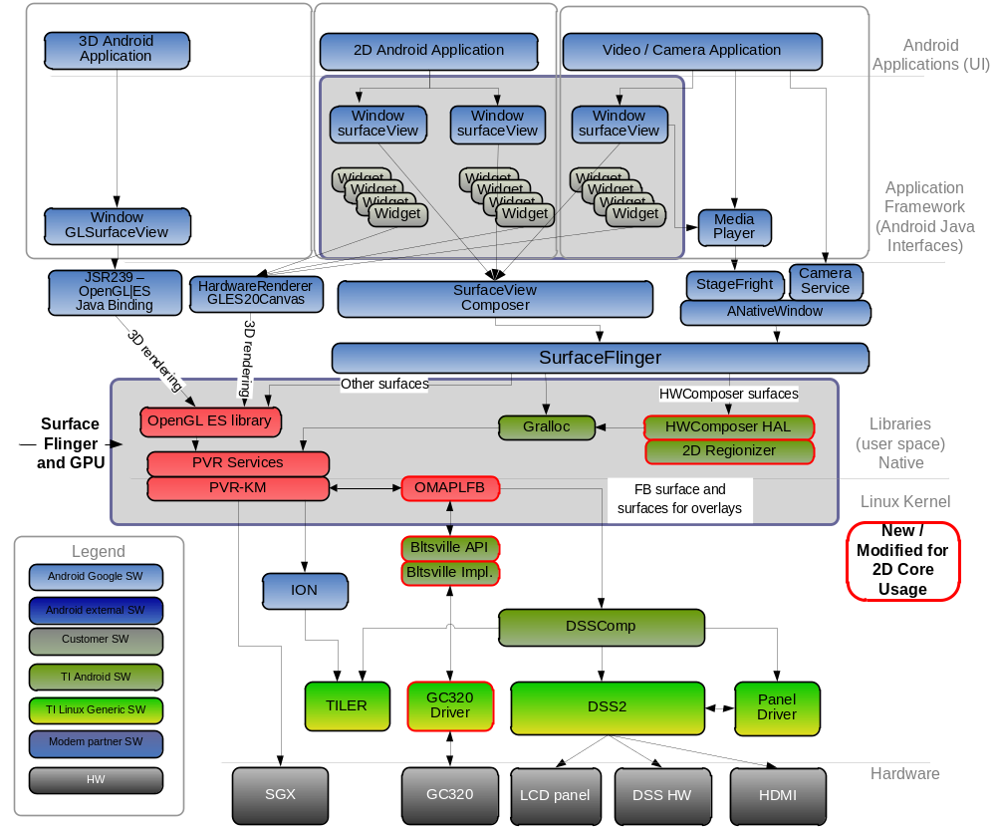
OMAP4470 Composition Architecture

Slide 4
OMAP4470 Composition Changes
TI’s HWC HAL implementation for ICS will still rely on DSS overlays as the primary choice for assigning both YUV and RGB layers when offloading them from the usual composition process on SGX.
HWC HAL policy will be updated to allow usage of GC320 blit & blend capabilities, in addition to using DSS overlay pipes. The goal is to offload composition tasks from the SGX whenever there is a power / performance benefit.
Policy will prefer DSS composition for a scenario with the right number of layers, but it can also send specific RGB layers to the GC320 for composition direct to the FB if needed.
Kernel implementation for the Bltsville API will be required to handoff surface buffers to GC320 and then synchronize output w/ FB updates.
GC320 driver will handle commands from the Bltsville implementation for specific 2D operations to be performed by the GC320 core.

Slide 5
Phased Approach to Android Composition Acceleration on 4470 – Phase 1
Phase 1:
Use 4460 ICS composition solution w/ SGX & DSS (no 2D core usage)
  Benefits from expanded usage of DSS overlays (ICS compared to HC).
  Offload additional RGB layers from SGX composition to DSS pipelines.
  This yields power savings on SGX, since it stays in a sleep state longer during each frame when there is no composition task.
  Saves memory BW by avoiding additional reads/writes required for SGX to compose layers into the FB.
  In many cases we can also bypass the FB entirely, saving even more BW.
Benefits from new SGX544-SC on 4470
  In cases where fallback to SGX is required, the architecture improvements allow for composition of layers at a faster rate compared to the SGX540.
  SGX544-SC shows a much better bus utilization compared to SGX540, which results directly in performance improvements.

Slide 6
Phased Approach to Android Composition Acceleration on 4470 – Phase 2
Phase 2:
Add support for further composition acceleration w/ the GC320
  Can send specific RGB format layers as input to the GC320 for composition direct to the FB.
  Offload additional layers from the SGX.
  This also yields power savings on SGX, when number of layers required for composition is more than what DSS can handle. SGX stays in sleep longer.
Support up to 4-plane blitting / blending for a single-pass composition
  Support color / format conversion from input to output along with blit/blend
  Support the two main framebuffer pixel formats as output:
    RGB16
    ARGB32
Simulation results show that w/ concurrent system traffic, the GC320 performs 4-plane 1080p blending > 2X faster than SGX544-SC

Slide 7
Example Scenarios to Benefit from 4470 ICS Composition Approach
Home Screen
Video Player w/ LCD + HDMI outputs
Camera App w/ settings window and notification panel
YouTube w/ search window, virtual keypad, and notification ticker
Assumptions:
  1920 x 1200 resolution display
  Surfaces are ARGB color format (except Video, e.g. NV12)
  Display is updated at 60 fps
See following slides for detailed descriptions of each scenario…

Slide 8
Home Screen
3 layers for composition:
  Wallpaper (1920 x 1128, ARGB)
  Launcher (1920 x 1128, ARGB)
  Status Bar (1920 x 72, ARGB)
4470 ICS composition approach:
  HWC HAL assigns all three layers to DSS pipelines when given opportunity.
  Allows bypassing composition to the FB entirely.
Benefits:
  Composition work is completely offloaded from SGX to DSS in this case.
  SGX sleep time is increased for additional power savings.
  Memory BW is significantly reduced by removing extra SGX reads/writes:
    SGX alone comp. + display: (2146 + 553) MB/s = 2699 MB/s
    4470 ICS comp. + display: 1073 MB/s
    Saves 60% of the original BW of SGX composition scenario

Slide 9
Video Player w/ LCD + HDMI outputs
3 layers for composition, and display on both outputs:
  Video (1920 x 1080, NV12)
  App UI/controls (1920 x 1128, ARGB)
  Status Bar (1920 x 72, ARGB)
4470 ICS composition approach:
  HWC HAL assigns 2 pipes for UI outputs and 2 pipes for video overlays.
  Since all 4 DSS pipes are already assigned for outputs, we can offload composition of the remaining ARGB layers to the GC320.
Benefits:
  Composition work can still be offloaded from SGX to DSS+GC320
  The FB is still mirrored to the HDMI output for UI cloning as usual
  GC320 composition time for ARGB layers to the FB is faster than SGX
  Therefore, we get additional power savings w/ GC320 by increasing the SGX sleep time.

Slide 10
Camera App w/ settings window and
notification panel
4 layers for composition:
  Viewfinder video (1920 x 1080, e.g. YUV)
  App UI/controls (1920 x 1128, ARGB)
  Status Bar (1920 x 72, ARGB)
  Notification Panel (768 x 1200, ARGB)
4470 ICS composition approach:
  HWC HAL assigns all four layers to DSS pipelines when given opportunity.
Benefits:
  Composition work is completely offloaded from SGX to DSS in this case.
  SGX sleep time is increased for additional power savings.
  Memory BW is significantly reduced by removing extra SGX reads/writes:
    SGX alone comp. + display: (1548 + 740) MB/s = 2288 MB/s (uses overlay for YUV surface)
    4470 ICS comp. + display: 961 MB/s
    Saves 58% of the original BW of SGX composition scenario

Slide 11
YouTube w/ search window, virtual keybd.
and notification ticker
6 layers for composition:
  Video window (854 x 480, e.g. YUV)
  YouTube App UI (1920 x 1128, ARGB)
  App popup (search) window (622 x 276, ARGB)
  Virtual keypad (1920 x 594, ARGB)
  Status Bar (1920 x 72, ARGB)
  Notification Ticker (540 x 96, ARGB)
4470 ICS composition approach:
  HWC HAL assigns YUV layer and 2 of the ARGB layers to DSS pipelines.
  Assign the remaining ARGB layers to the GC320.
Benefits:
  Composition work can still be offloaded from SGX to DSS+GC320
  GC320 composition time for ARGB layers to the FB is faster than SGX
  Memory BW is significantly reduced by removing extra SGX reads/writes:
    SGX alone comp. + display: (1760 + 590) MB/s = 2350 MB/s (w/ YUV on overlay)
    4470 ICS comp. + display: (173 + 1384) MB/s = 1557 MB/s (savings of 34% BW)

